Slide 1

2020 Spotify Trends
Júlia Rodriguez
Marcos Palacios

Slide 2
“Los grandes artistas copian, los
genios roban”.
Pablo Picasso.

Slide 3
Objective
Rebuilding the database of the top songs of 2020:
Finding the most representative songs of 2020
Structuring the database

Slide 4
Data Origins and Destination
Spotify API
AnnualReport
Spotify Charts
Dataset
BigQuery
WordCount
3 tables:
daily_songs
unique_songs
lyrics
lyricsgenius
SongProperties

Slide 5
Sources of Data
Spotify Charts
Top 200 streamed tracks for every day of the year
Web Scrapping
Spotify API:
Id, Track, Artist, Genre, Song Properties...
Public API
lyricsgenius
Python client for the Genius.com API
Genius world's biggest collection of song lyrics
Web Scrapping
Data
Cleaning
Dataset

Slide 6
Data warehouse:
Google BigQuery

Slide 7
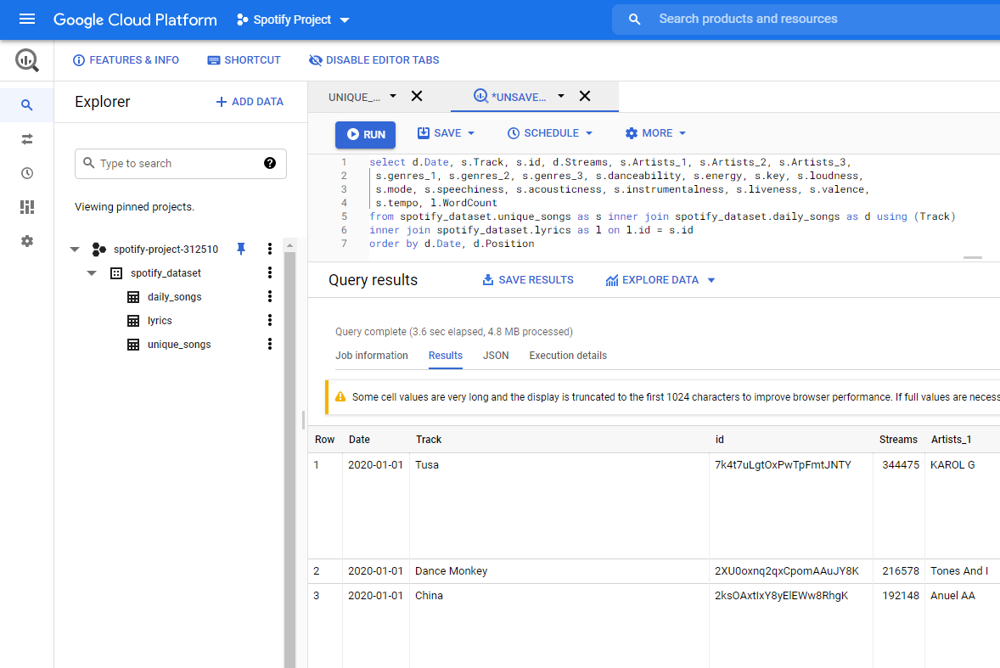

Slide 8
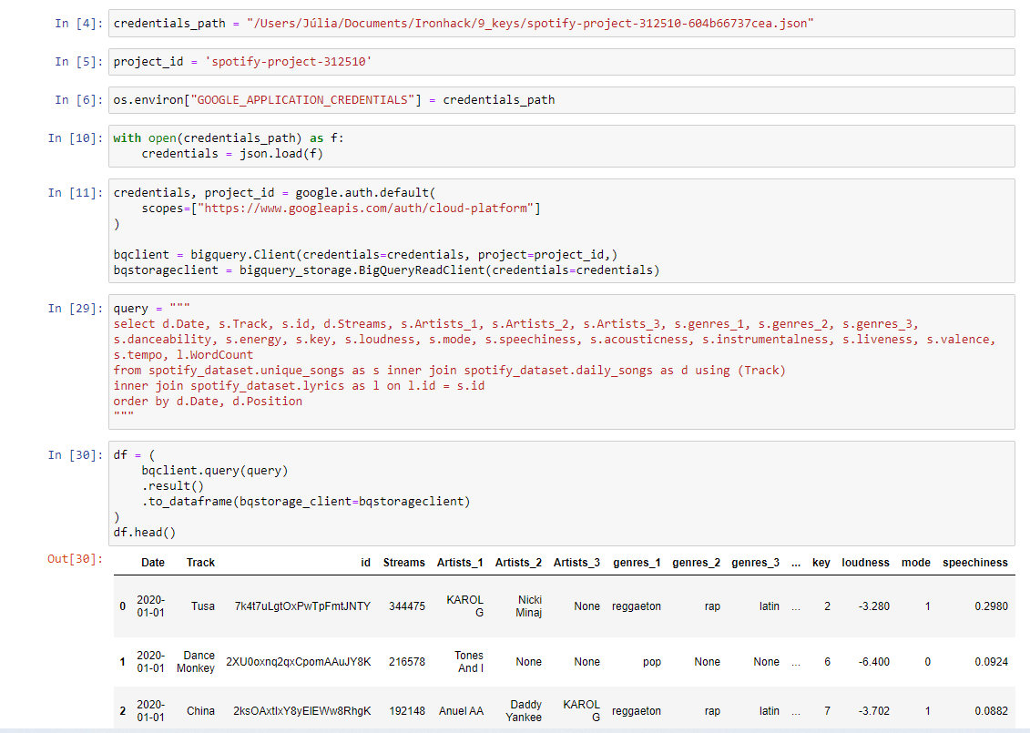

Slide 9
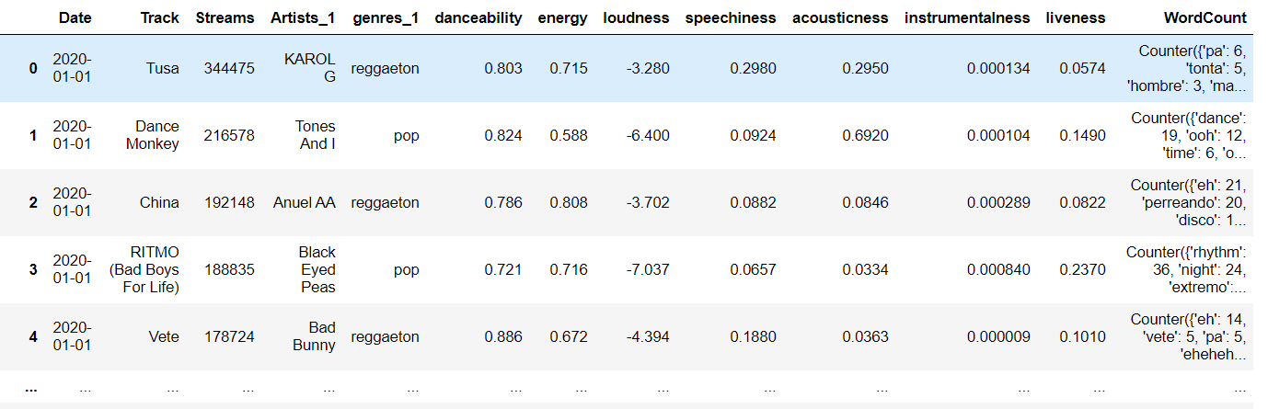
Data Treatment
AnnualReport
Generated from the overall data.
Main Dataset

Slide 10
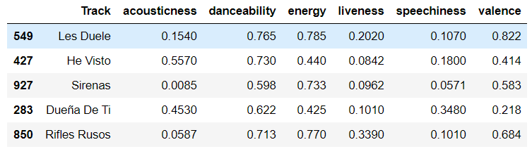
Data Treatment
SongProperties
Derived from AnnualReport

Slide 11
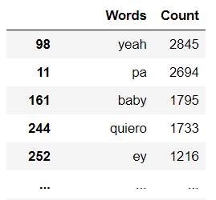
Data Treatment
WordCount
Derived from AnnualReport.
Cleanup
Counting
False positives
Caps, punctuation, spaces, accents…
Stopwords
Scrapped Lyrics
Bag of Words

